Slide 1
South Summit Mountain Bike Team
Leif Cox and Dave Scott
Head Coaches
Text/Phone: 406-498-8876
Email: leifhcox@gmail.com
April 2023

Slide 2
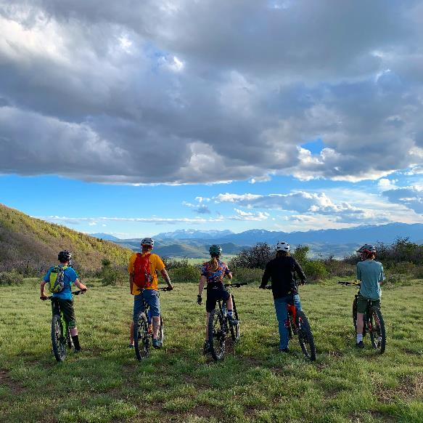
NICA
Five Core Principles
Fun
Inclusivity
Respect
Equity
Community
nationalmtb.org

Slide 3
A little history…
Utah High School Cycling League started in 2012
SSMBT started in 2016 with 6 riders
In 2022 SSMBT had 6 riders & placed 1st or 2nd in each of our regional races, 7th out of 33 D2 schools at State Championships
2022 season highlight video
State Champs last year were the biggest high school sporting event ever (anywhere!) with over 2500 participants
In 2023 the UHSCL expects 9000+ riders across 6 regions

Slide 4
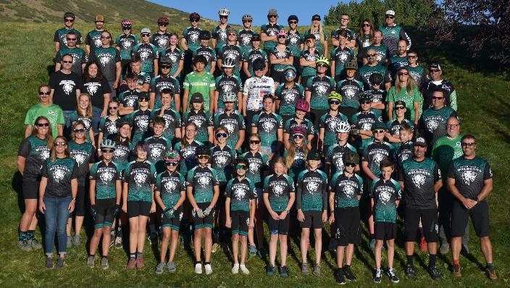
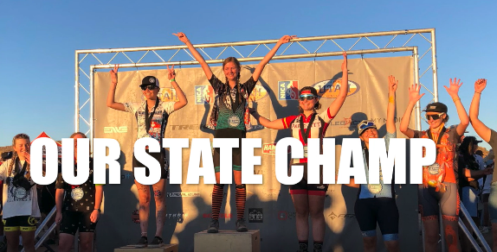
2023 South Summit Mountain Bike Team
South Summit Mountain Bike Education Foundation Goals
Support students of all abilities who have the desire to mountain bike with the coaching camaraderie to foster mountain biking as a competitive and lifelong sport
Develop amateur athletes who are both gracious and respectful
Establish a responsible attitude toward the use of trails
South Summit Mountain Bike Team Goals
Be safe and have fun!
Learn fundamentals of biking and progress to lifelong riders
Support athletes who want to be competitive at a high level
Be a team podium contender every year

Slide 5
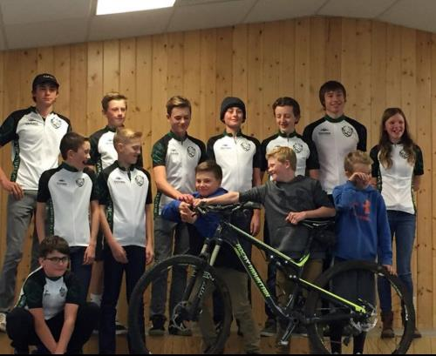
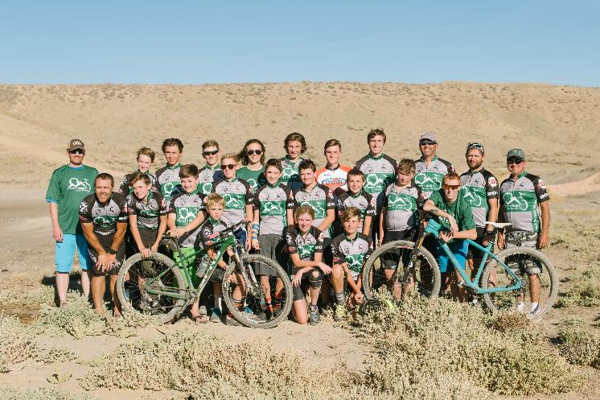
2018: 22 Athletes
2017: 12 Athletes

Slide 6
2019: 38 Athletes
2020: 44 Athletes

Slide 7
2021: 54 Athletes

Slide 8
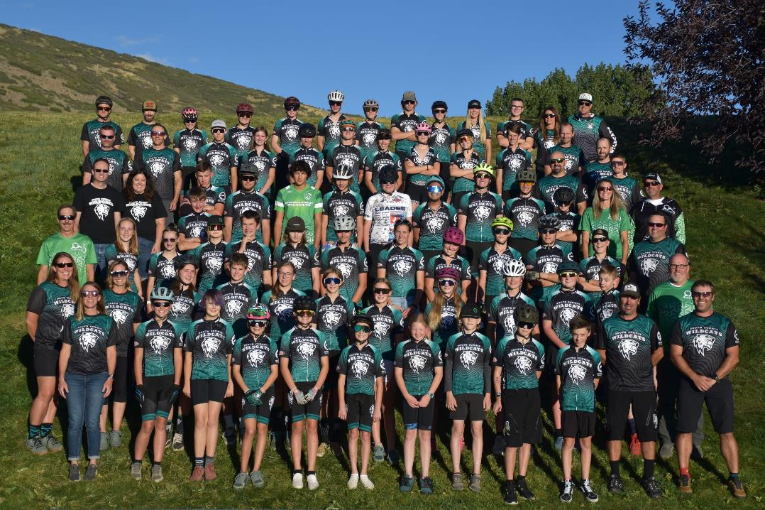
2022: 66 Athletes

Slide 9
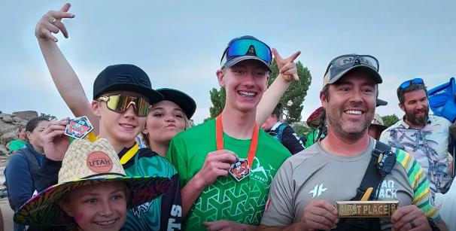
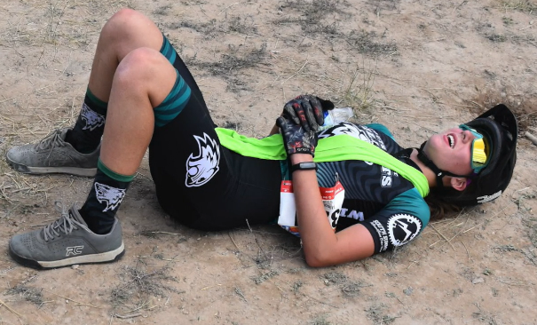
Team Philosophy
Have fun!
Be safe
Work hard
Challenge yourself
Be nice
Be a good example and motivator for your teammates. Help them when they need it.
We are a team

Slide 10
Team Philosophy
Do I have to race?
Yes! We are a cross-country race team! But sort of no. Train and participate as if you were going to race, and be the best biker you can be by race season. You’ll be ready. If you more convincing by the first race, just come, cheer, and help. By the second one you’ll be ready!
Do I have to come to practice?
Yes! When you are in town.
Summers are for family vacations, camps, etc. These take priority!
When you are in town, come to practice.
A big part of bike team is learning to push yourself and do hard things. Commit to the team, do it, and you’ll have a ton of fun.
If you can’t be on time, be early!!

Slide 11
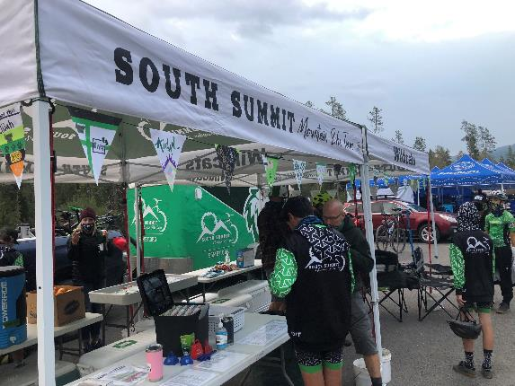
Team Calendar
Google calendar
Posted on website: www.ssmbt.org/schedule/
Preseason is TBD!!!!
Relax, we have plenty of riding and it’s still early spring
We will push out preseason activities when trails are available
May 5-7: McCoy Flats Campout
June 1: Official season start
June 2-4: Three Peaks Campout
June 17: Six Hours of Slate Creek
Some Saturday fun rides (see calendar)
Races (*Consider making lodging arrangements)
August 26: Soldier Hollow
September 9: Eagle Mountain
September 23: Vernal*
October 7: TBD (High School Only)
October 20-21*: State Championships at Cedar??? (by qualification, book refundable!)

Slide 12
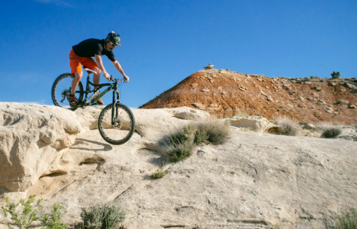
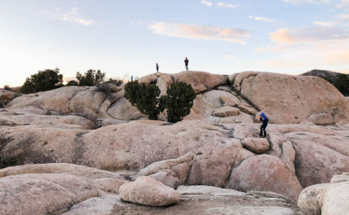
Preseason Activities (completely optional)
We have two campouts planned
Parent Lead!
Each athlete must have an adult accompanying them who is responsible for them when not biking
Coaches are only leading when on a ride
McCoy Flats
May 5-7
Vernal Area
Three Peaks
June 2-4
Cedar City Area
Cost is nominal ($10s)
Includes some meals and campground reservations
Other practices?
Coming soon…
Get on the email list and sync to the calendar (or check the website)

Slide 13
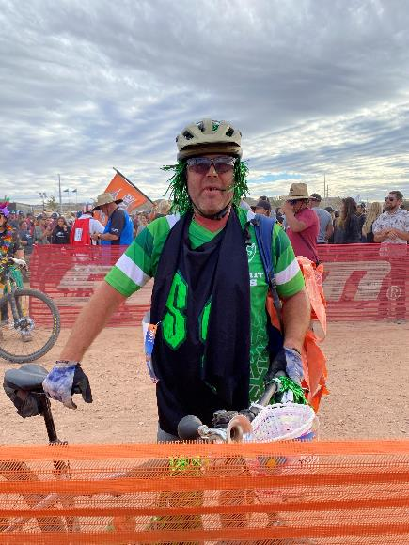
Team Communications
(Approximately) weekly emails for weekly communications and planning
GroupMe App for quick questions, venue changes, practice cancelations, general mayhem, etc
I’ll send a bulk invitation to GroupMe, or ask to be invited
Phone call or text to Leif or Dave
Leif: 406-498-8876
Dave: 801-885-2008
Leigh: 435-602-0000
Website has documents and links

Slide 14
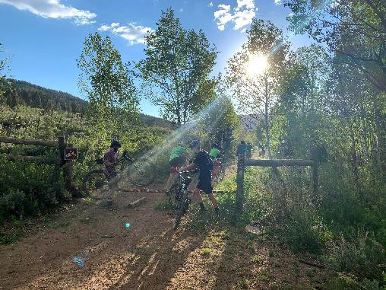
Practices
Practices 3 days per week:
Monday, Wednesday, and Thursday
Monday, Wednesday, and Saturday
Regular practice season starts June 5th
Time: 6:00 pm - 8:00 pm
Locations: Yellow Pine/Slate Creek/Beaver Creek, Oakley Bike Park, Marion Park, Coyote, others
Longer team rides are schedule for Saturday

Slide 15
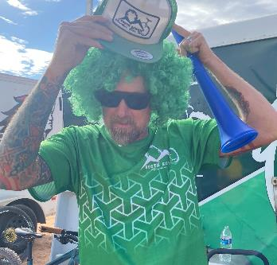
Coaching
We are always looking for more coaches
The entire team is managed and coached by volunteers
You do not have to know how to mountain bike, just be enthusiastic and interested in helping our student-athletes!
Obtaining a NICA level 1 requires about 4 hours of online work
You are welcome to come ride with the team for a day to see what it is all about
OTB 101 is this Saturday (April 15) at the High School Parking Lot. 10 am for a few hours

Slide 16
Non-riding parent volunteers are needed as well
League volunteering at races
NICA races require a huge volunteer effort
One person for each athete is expected to volunteer once per season
Campouts
Oversee food, menu, and camp in general
Trail work days
Every athlete and an adult should volunteer for one trail work day
Six Hours of Slate Creek
Count laps, BBQ, judge costumes
Team Dinner
Just what it sounds like
Pit zone
Help with setup, tear down, food, general chaos manager

Slide 17
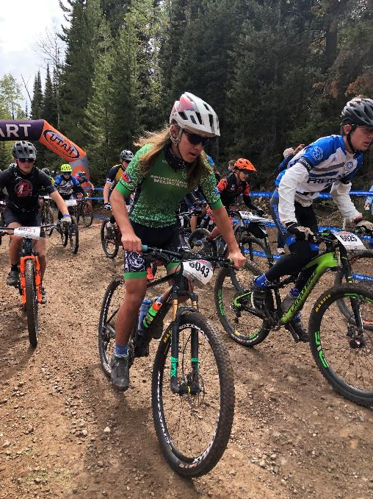
Registration
Step 1) Team Registration
Fill out the Google Form here:
https://forms.gle/YcqJJGVhnRvaFSK48
Open until June 1st
Please register ASAP
Cost: $130
Scholarships available, contact head coach or board member for more information
Team dues include kit (jersey, bibs, race day bag, track suit, socks)
Step 2) Team Payment
Nate McEntire will send you an electronic invoice via email
We will contact you first if you requested scholarship consideration
Once you have paid your team dues
Step 3) NICA League Registration
For new athletes, you will receive an invitation to register via email
For returning athletes, you will receive a notification that your account will let you register
Open until June 1st
Must register before attending 2nd practice
Cost:
High School $300 (NICA dues)
Middle School $250 (NICA dues)

Slide 18
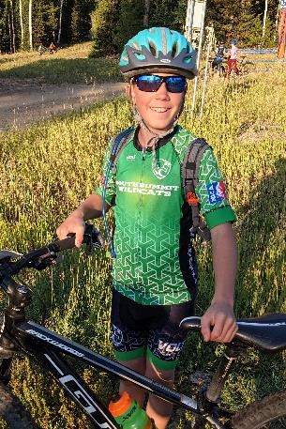
A la carte clothing orders
A La Carte sales are welcome from everyone
Parents, coaches, community members
We will sell items at campouts, BBQs, after a few selected practices
All kit items plus
Gloves
Hats
T-shirts
Baggy shorts
Baggy jerseys
Nate McEntire has worked tirelessly to put all the kits and clothes together! Thank you!

Slide 19
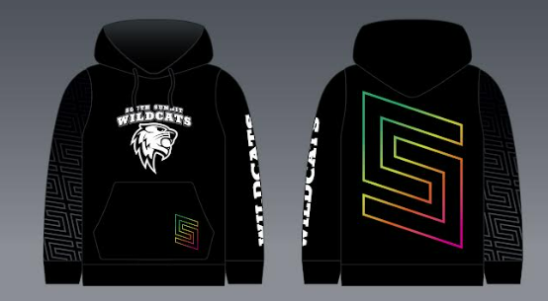
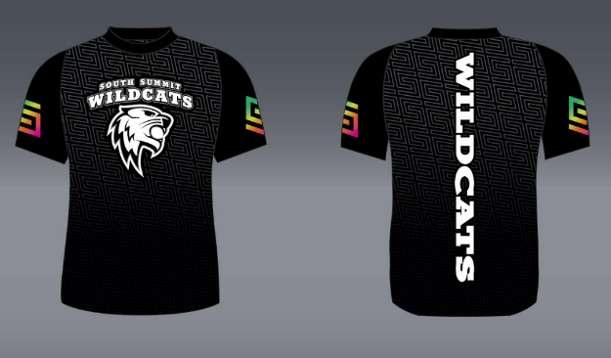
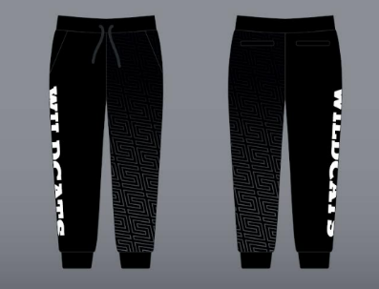
Sweatshirt
Baggy Jersey
Sweatpants

Slide 20
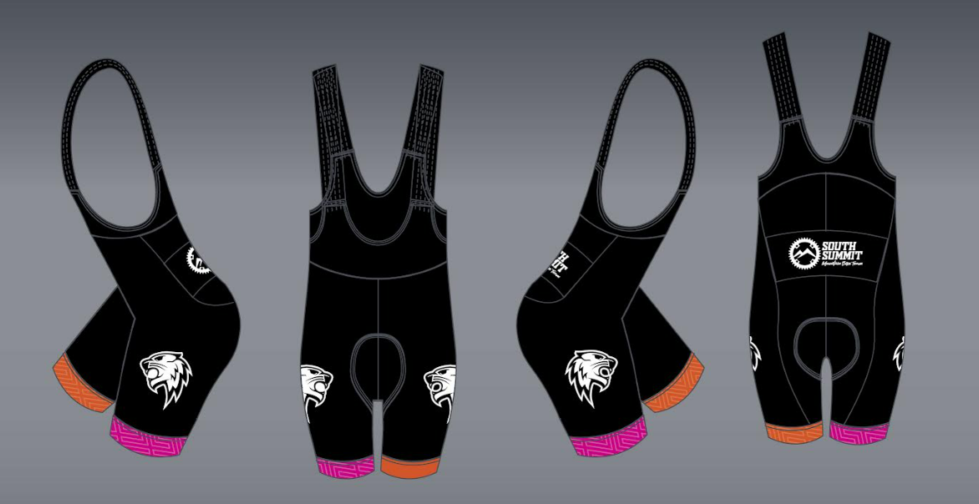

Slide 21
2023 South Summit Race Kits

Slide 22
Equipment
Equipment required for practice and races
Bike
Helmet
Gloves
Close-toes shoes
Protective eyewear
20 oz of water for cool practices, 48 oz for long or hot rides
Proper clothing for conditions
Nutrition (gels, fruity snacks, granola bar, etc)
Fix Kit
Spare tube—make sure value type fits your bike
Pump or CO2 with head
Patch kit (for tubes) or tire plugs (for tubeless)
Tire levers
Multi-tool (with a chain breaker for High School athletes)
Master link (chain speed specific!)
Medications: Any medications athlete will need, self-administered.
Items to have at home for maintenance.
Above mentioned fix-kit
Simple green or “muck off” for cleaning.
Brush kit and soap bucket.
Chain lube and brush
Finding a bike Biking can get expensive!
KSL is a great place to look, but ask Leif, Dave, or Brian for help
Several good bikes are for sale within the team
Loaner bikes are available from the team

Slide 24
New Region 5
Lehi D1
Lone Peak D1
Maple Mountain D2
Payson D2
Salem Hills D3
Skyridge D1
South Summit D2
Spanish Fork D2
Springville D3
Vernal D2
Wasatch D1

Slide 25
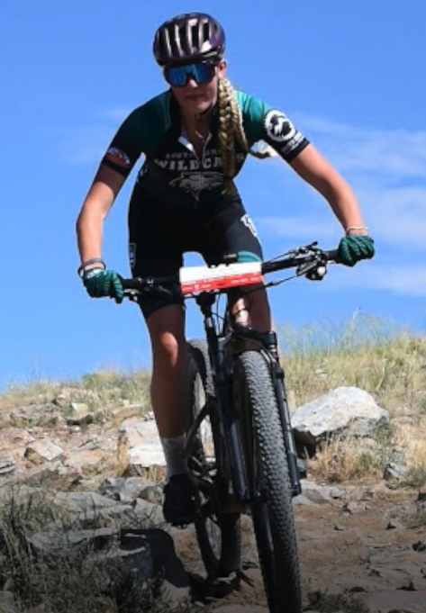
Team Deals
High Mountain Cycling
In Francis
20% off all tunes
Keith Baumgartner: 801-913-9522
Storm Cycles
15% off everything
Some good deals on bikes, but stock is limited—ask at Storm

Slide 26
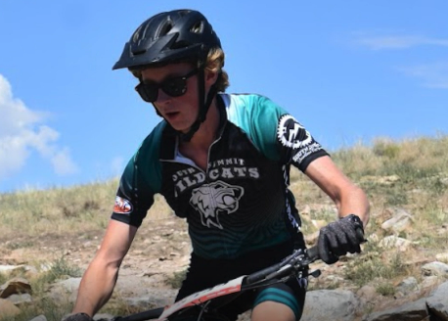
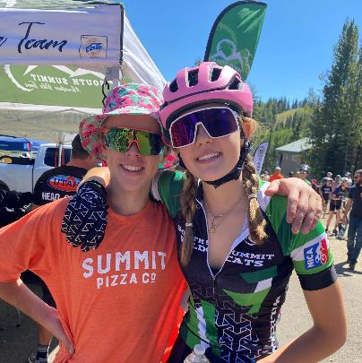
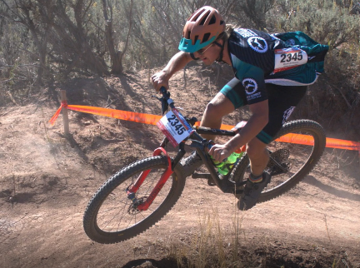
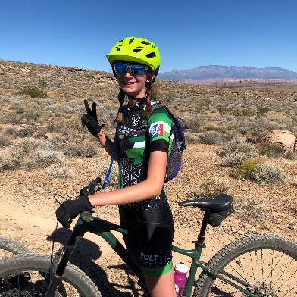
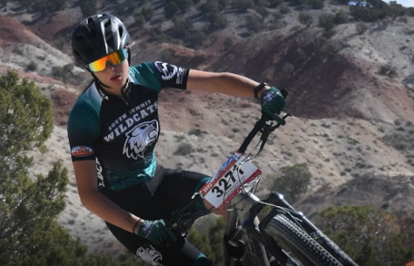
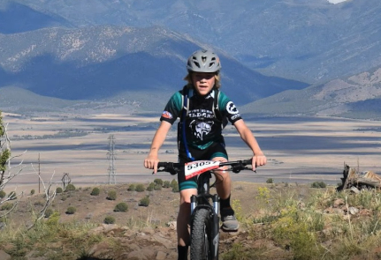

Slide 27
Green Level
Silver Level
White Level
*We get no school funding

Slide 28
My Goals
Explore new trails
Have a training and skills plan that is fun, motivates, and creates the highest level of fitness
Win Regionals and 1 other regular season race
Place in the top 5 at State Championships
Have every athlete dramatically improve and return in 2024

Slide 29
SSMBT Contact Info
Head Coaches
Leif Cox: leifhcox@gmail.com 406-498-8876
Dave Scott: dscott@indsupply.com 801-885-2008
Brian Henneuse: brianhenneuse@gmail.com 720-630-9038
JD Head Coach
Leigh Anderson: leigh.ditta@gmail.com 435-602-0000
Team Director
Erica Evans: e04evansj@gmail.com 435-640-2201
SSMBEF Board Members
Rolf Petersen: rolf.4@netzero.net 801-557-7947
Matt Weller: matt.weller1@outlook.com 435-300-4940
Nate McEntire: nmcentire2002@yahoo.com 801-901-8066
Plus Dave and Leif

